Slide 1

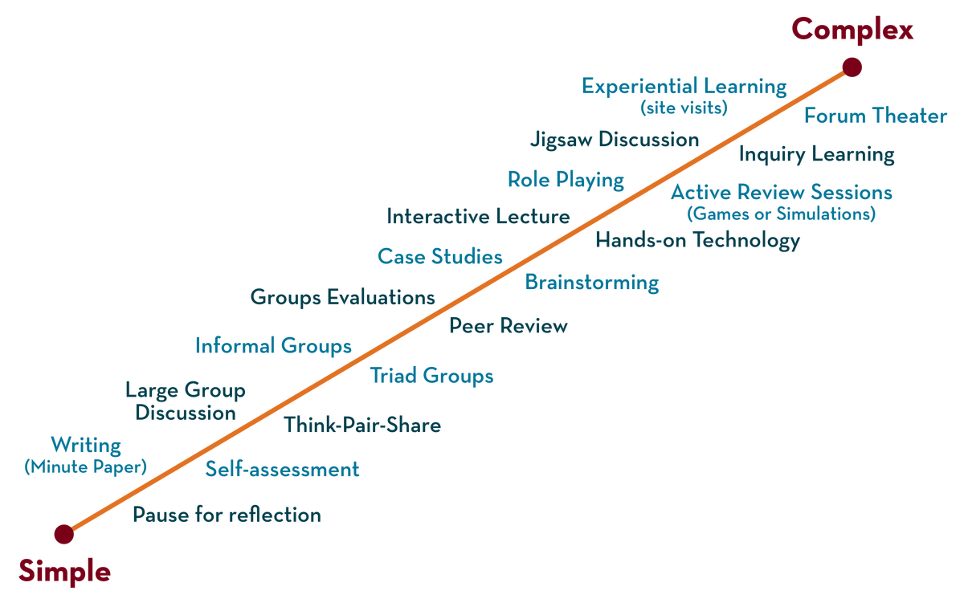
Department of CSE
FRONT END WEB DEVELOPMENT (EPAM)
21CS3017AA/21CS3017PA
Topic:
HTML Basics
Session - 4

Slide 2



AIM OF THE SESSION
To familiarize students with the basic concept of HTML5
INSTRUCTIONAL OBJECTIVES
This Session is designed to:
Basic Tags of HTML5
Advanced Tags
Validations
LEARNING OUTCOMES
At the end of this session, you should be able to:
Design a static web pages/web application
Apply the Validation on pages
Summarize the Semantic tags to design the application

Slide 3
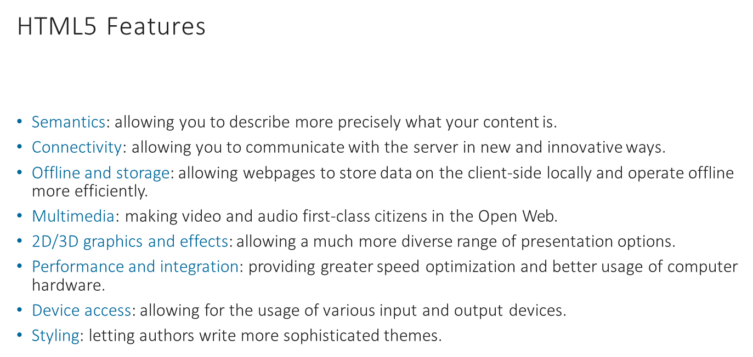
SESSION DESCRIPTION

Slide 4
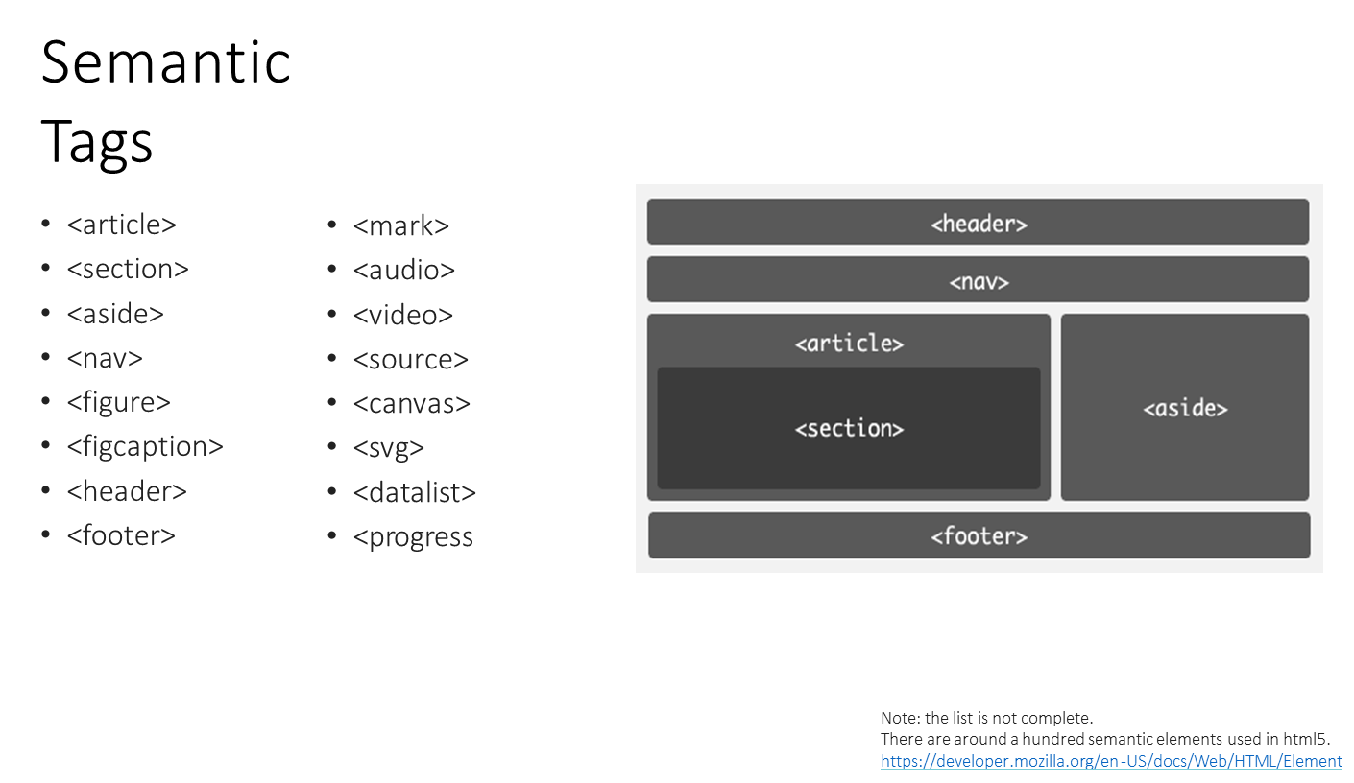
SESSION DESCRIPTION

Slide 5
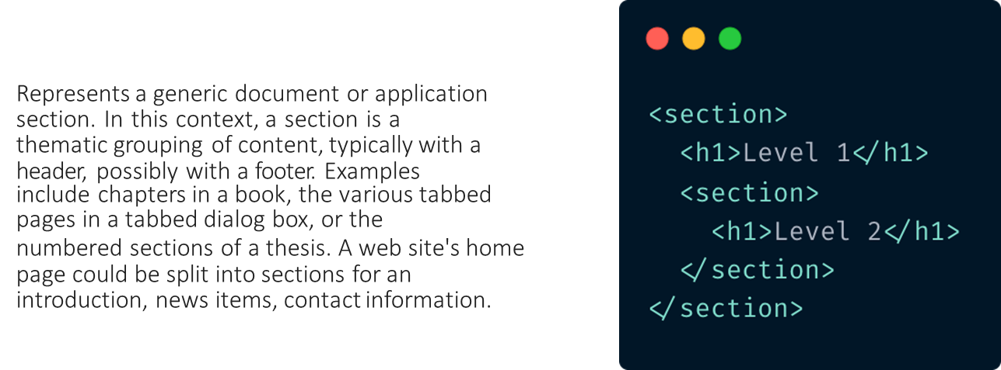
SESSION DESCRIPTION
When to Use:
When you want to group content thematically (e.g., a "Contact Us" section, "FAQ", "News", etc.).
To improve the readability and accessibility of your HTML content.
Section

Slide 6
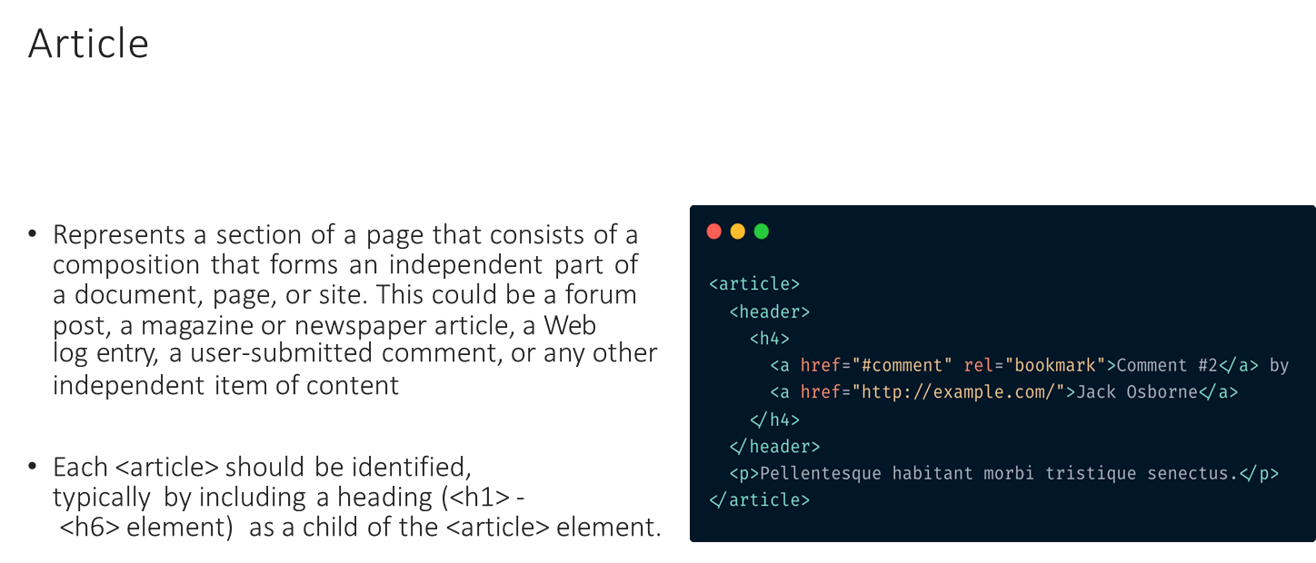
SESSION DESCRIPTION

Slide 7
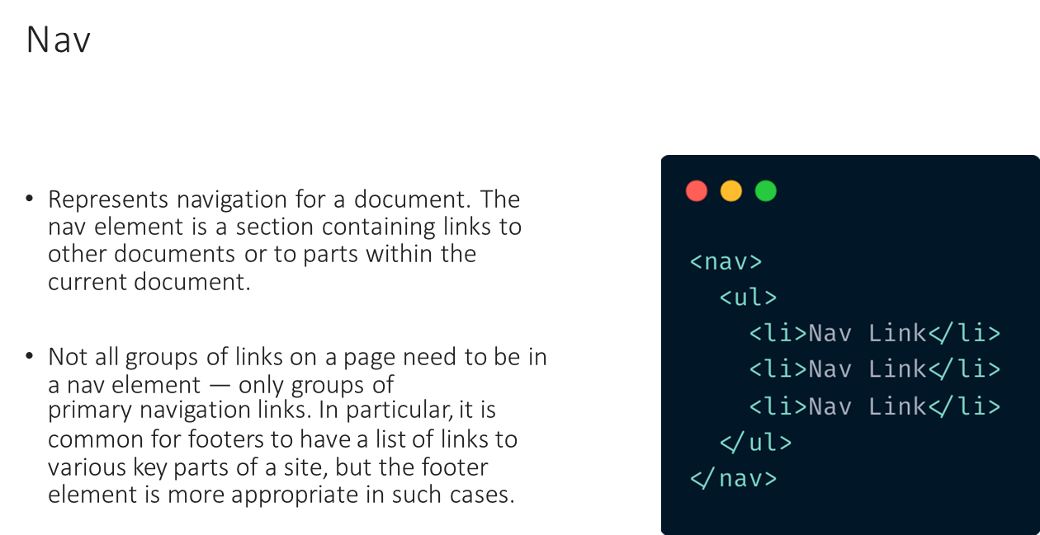
SESSION DESCRIPTION (Cont..)

Slide 8
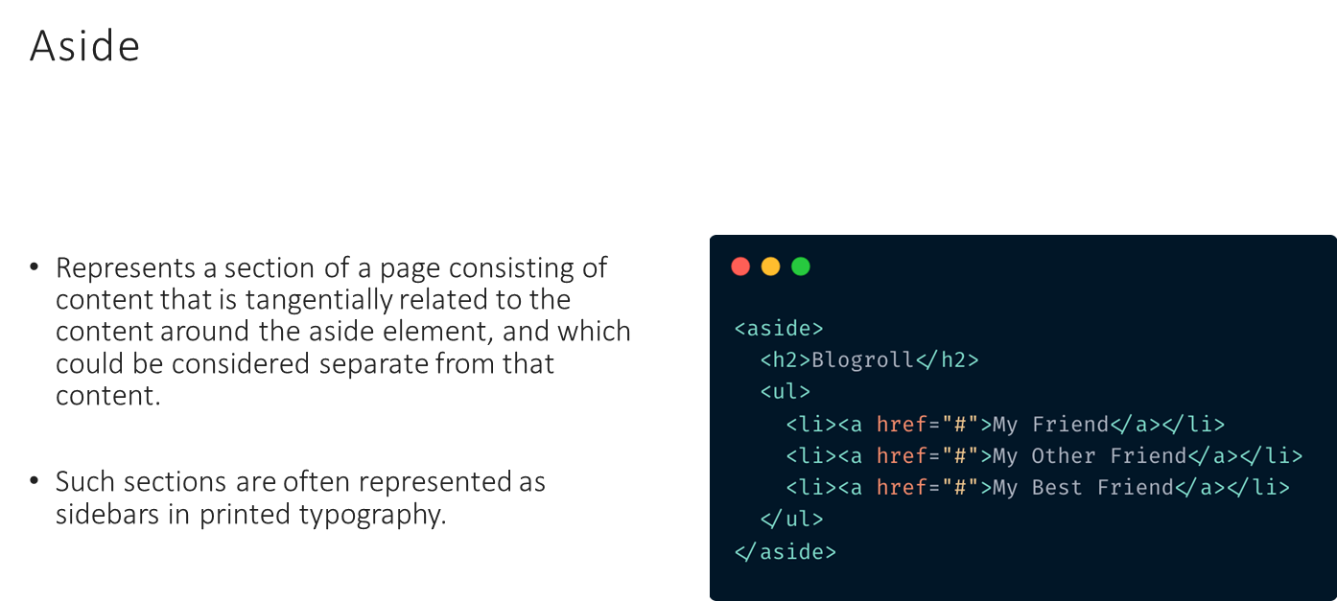
SESSION DESCRIPTION

Slide 9
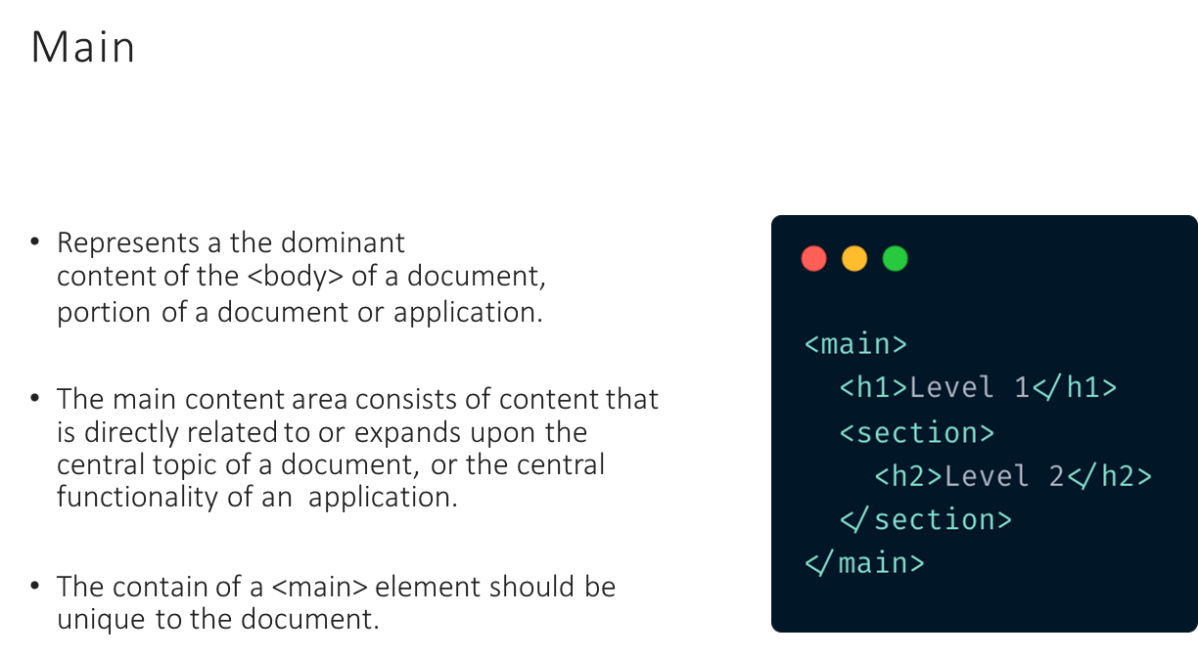
SESSION DESCRIPTION

Slide 10
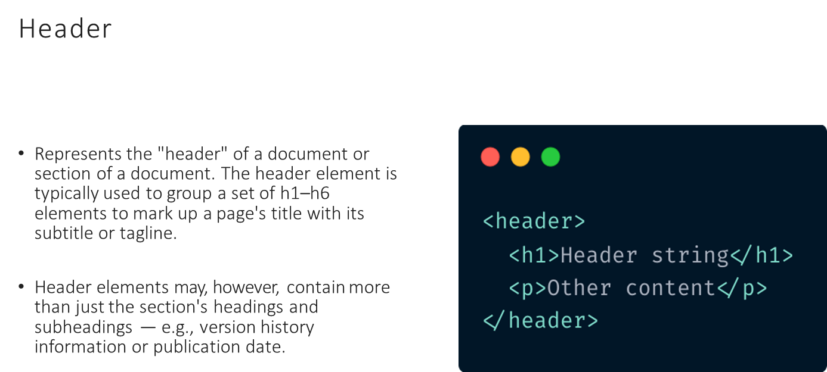
SESSION DESCRIPTION

Slide 11
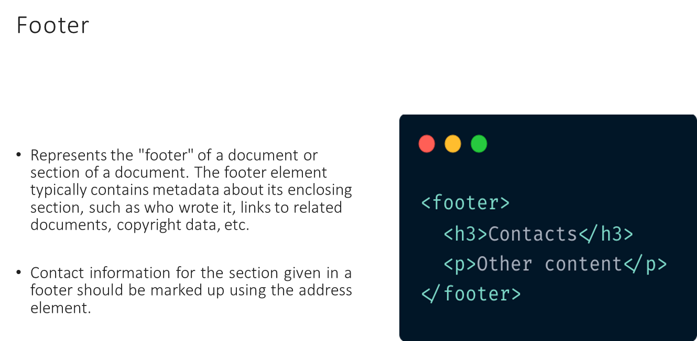
SESSION DESCRIPTION

Slide 12
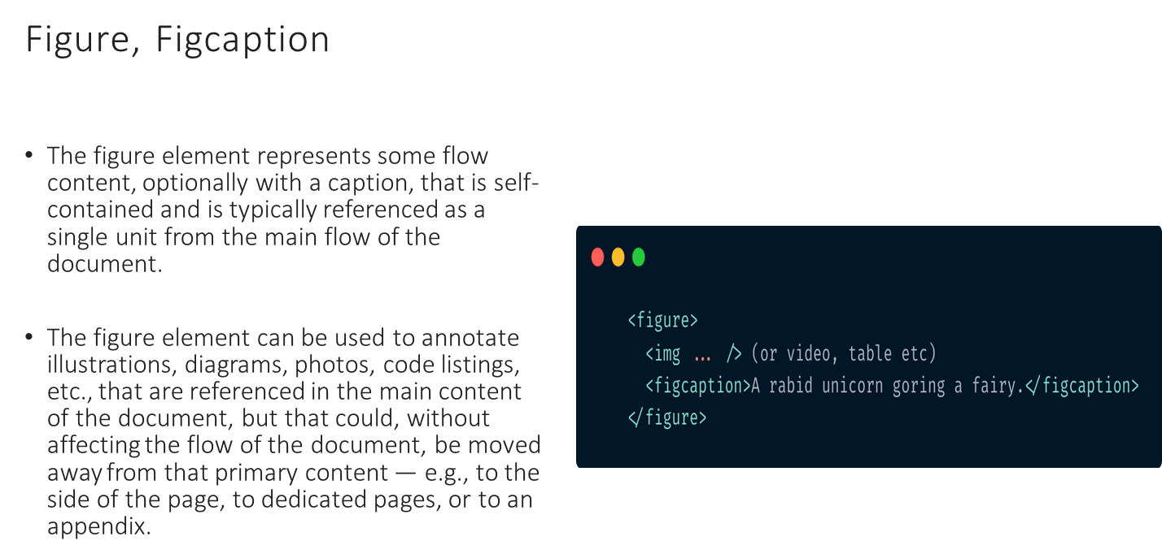
SESSION DESCRIPTION

Slide 13
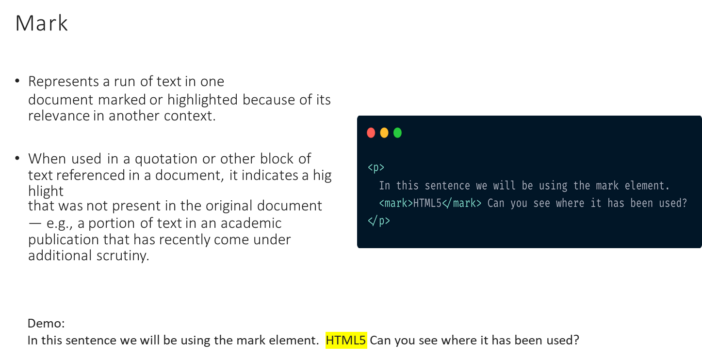
SESSION DESCRIPTION (Cont..)

Slide 14
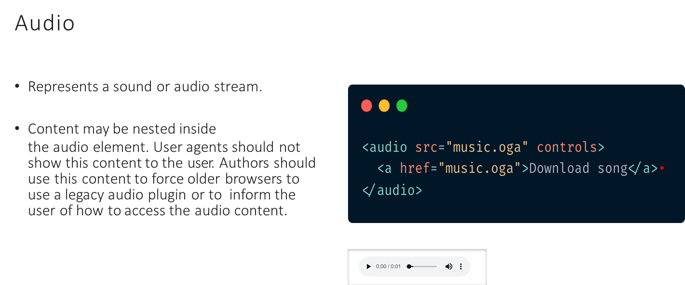
SESSION DESCRIPTION

Slide 15
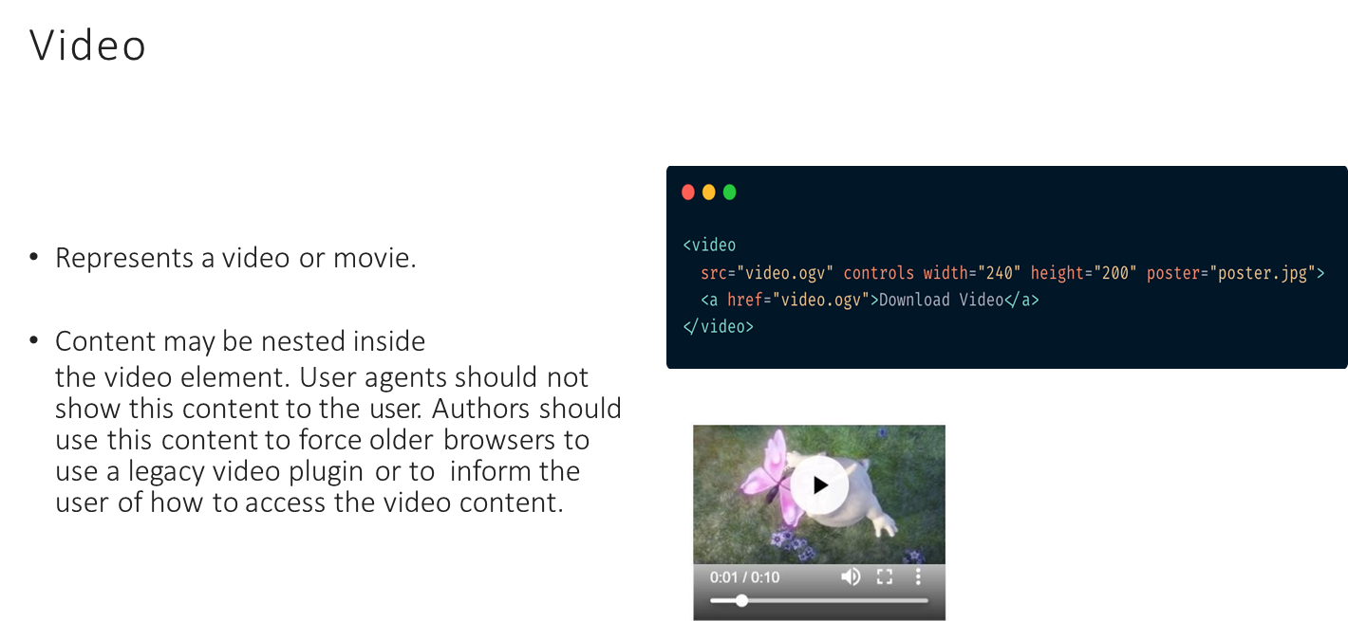
SESSION DESCRIPTION

Slide 16
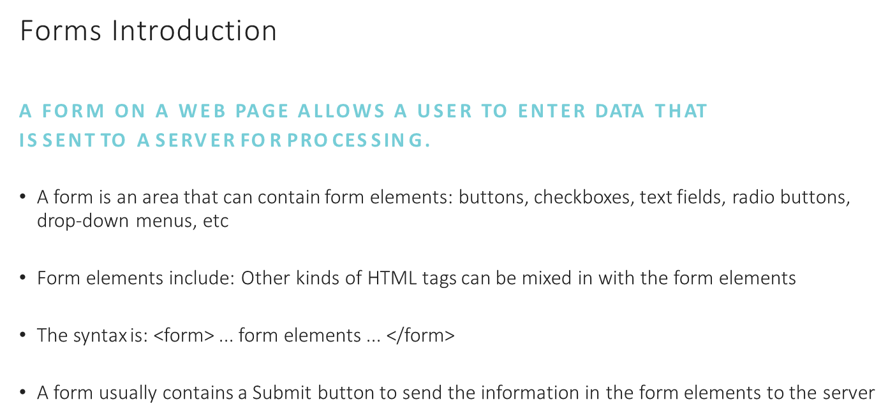
SESSION DESCRIPTION

Slide 17
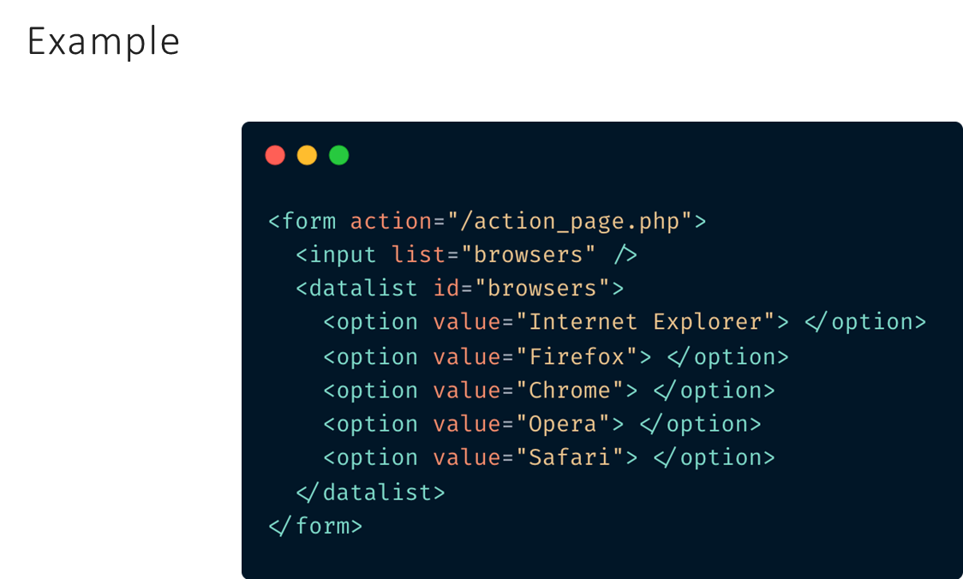
SESSION DESCRIPTION (Cont..)

Slide 18
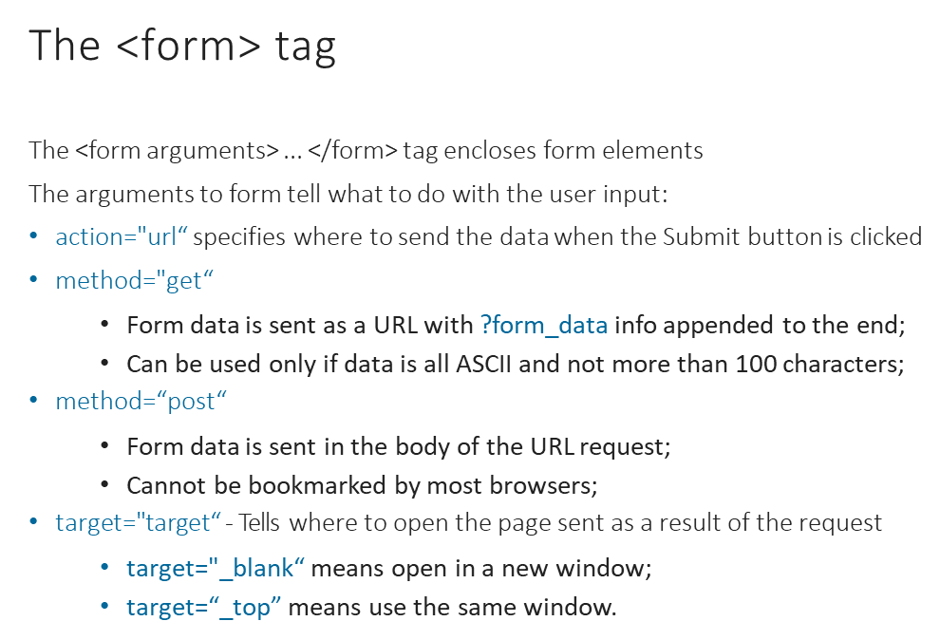
SESSION DESCRIPTION (Cont..)

Slide 19
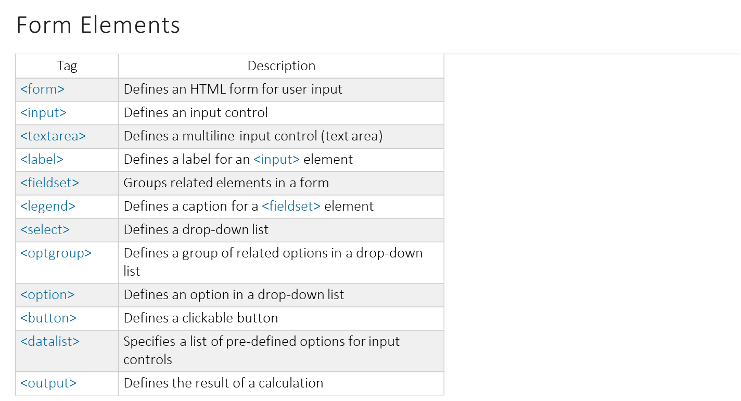
SESSION DESCRIPTION (Cont..)

Slide 20
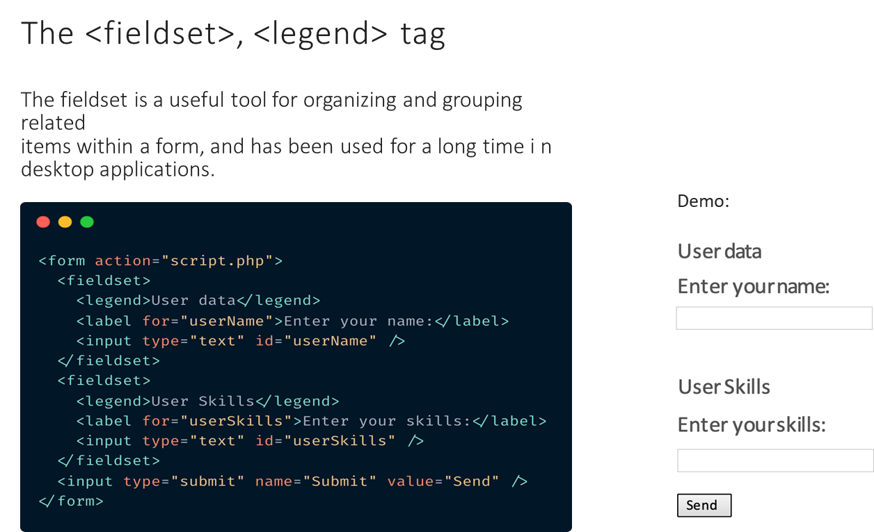
SESSION DESCRIPTION (Cont..)

Slide 21
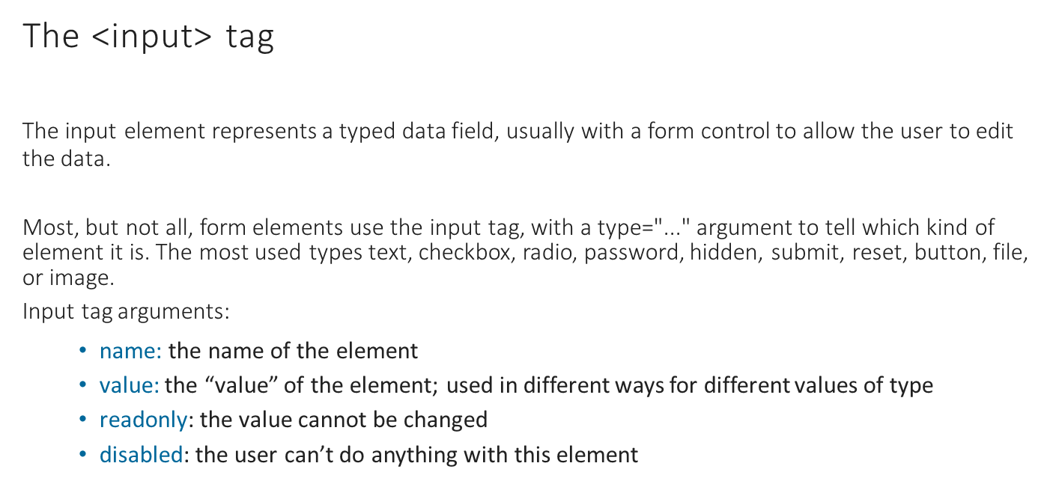
SESSION DESCRIPTION (Cont..)

Slide 22
SESSION DESCRIPTION (Cont..)
Input Types
The most important form element is the <input> element. This element can be
displayed in several ways, depending on the type attribute:
text;
password;
submit;
radio;
checkbox;
button;
color;
date;
datetime-local;
email;
month;
number;
range;
search;
tel;
time;
url;
week;
See full list: https://developer.mozilla.org/en-US/docs/Web/HTML/Element/input

Slide 23
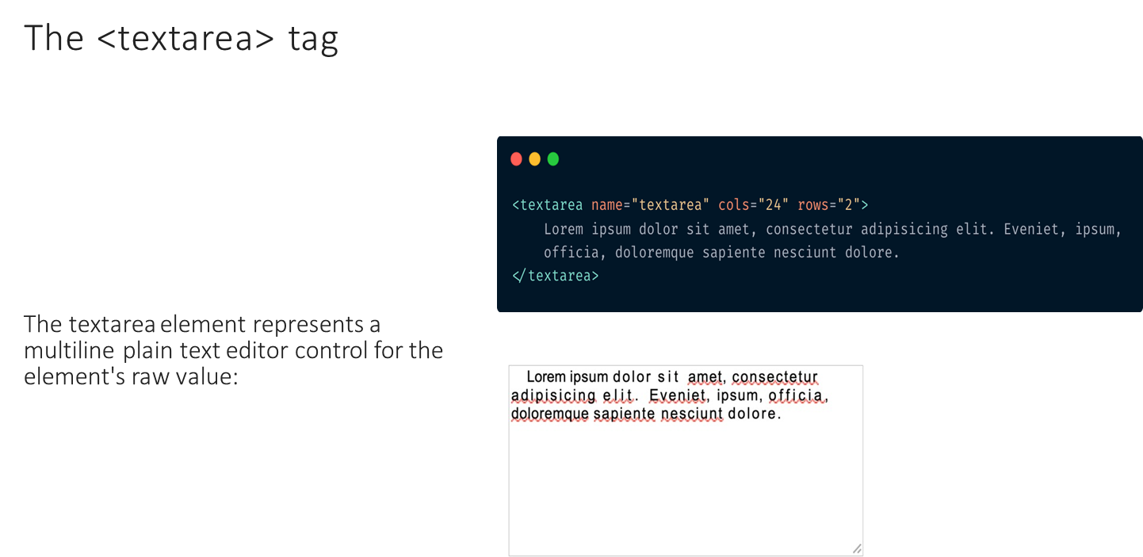
SESSION DESCRIPTION (Cont..)

Slide 24
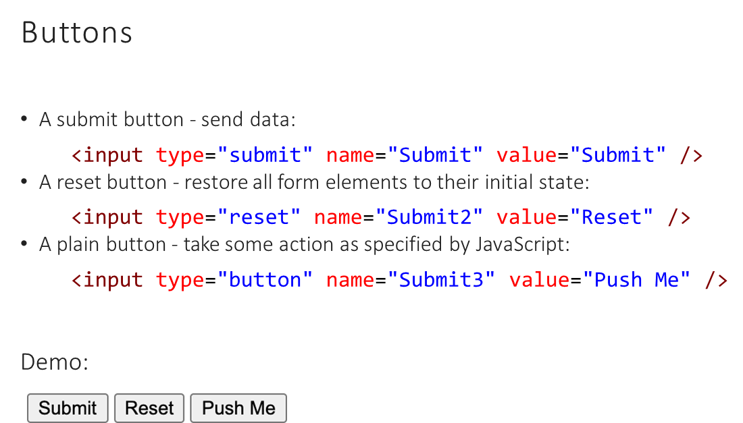
SESSION DESCRIPTION (Cont..)

Slide 25
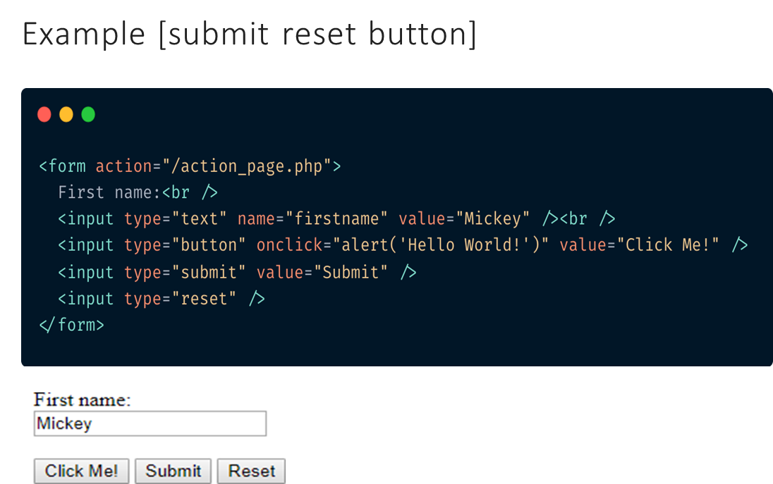
SESSION DESCRIPTION (Cont..)

Slide 26
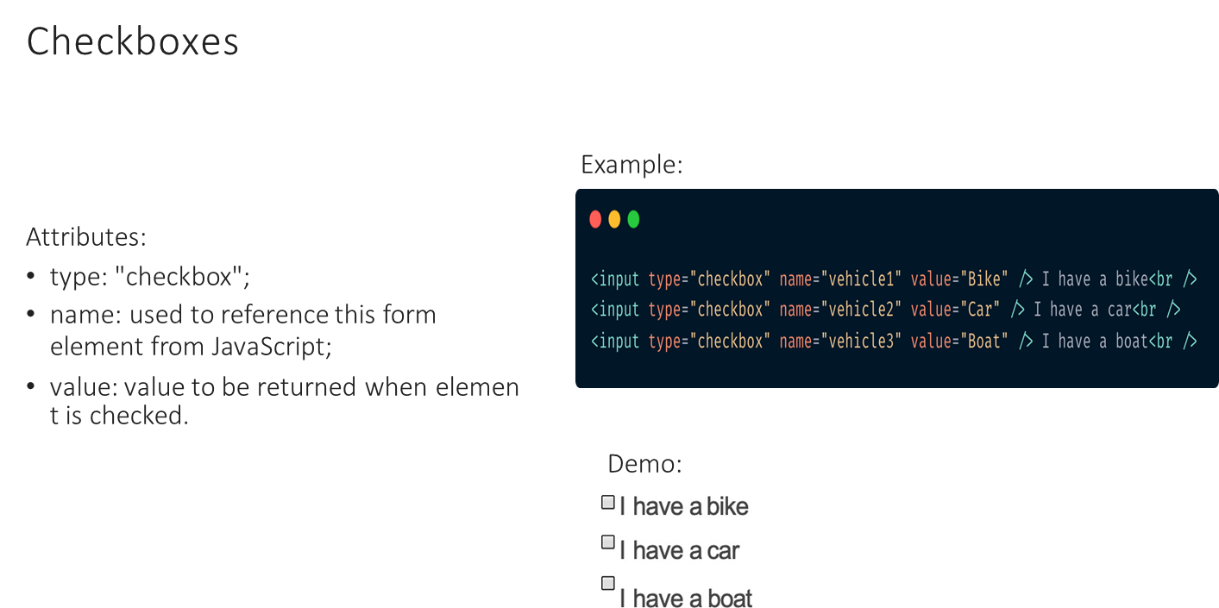
SESSION DESCRIPTION (Cont..)

Slide 27
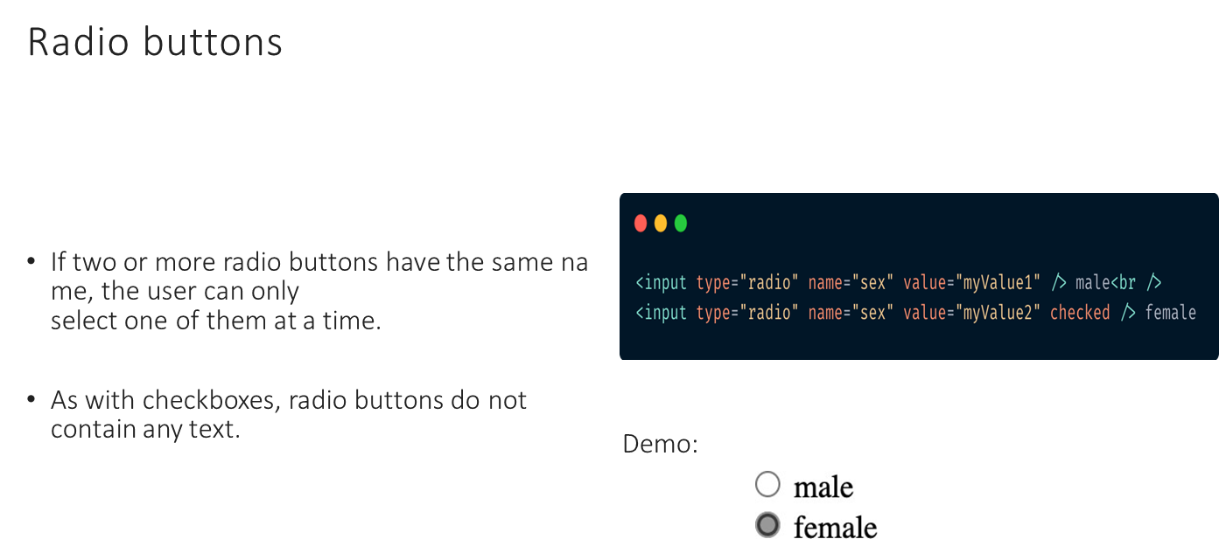
SESSION DESCRIPTION (Cont..)

Slide 28
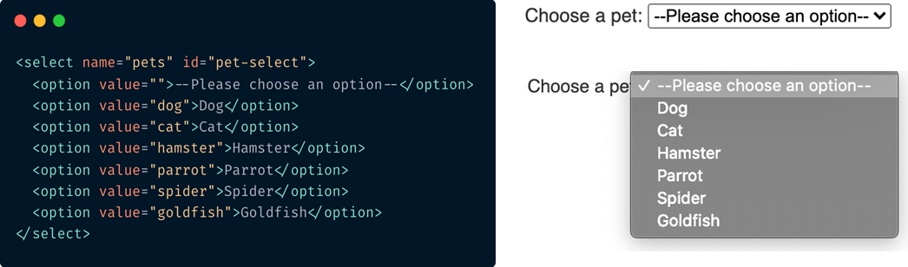
SESSION DESCRIPTION (Cont..)
Select element
The <select> HTML element represents a control that provides a menu of options
Each <option> element should have a value attribute containing the data value to submit to the server when that option is selected. If no value attribute is included, the value defaults to the text contained inside the element. You can include a selected attribute on an <option> element to make it selected by default when the page first loads.
Attributes:
autocomplete
autofocus
disabled
form
multiple
name
required
size

Slide 29
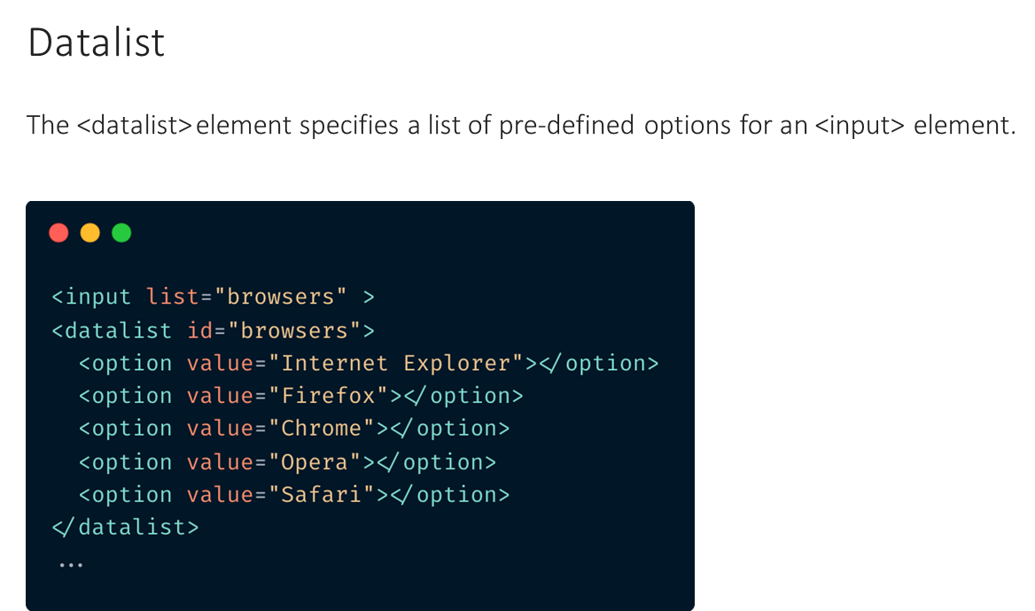
SESSION DESCRIPTION (Cont..)

Slide 30
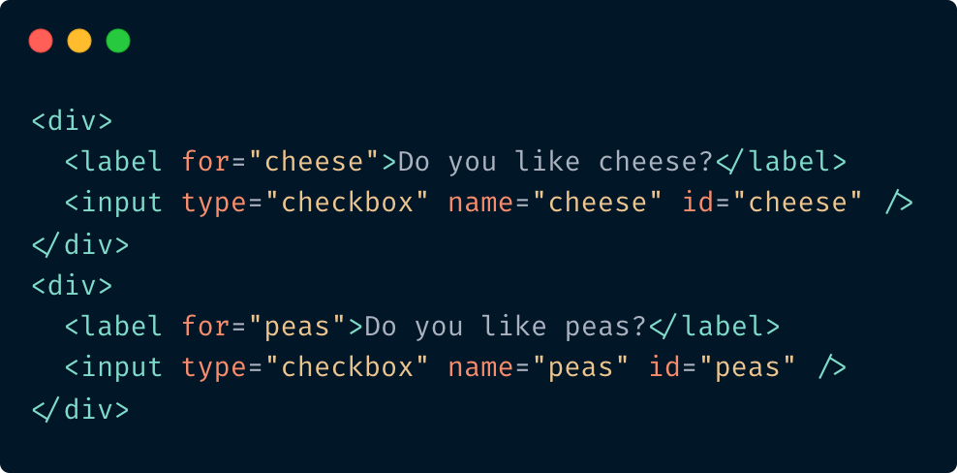
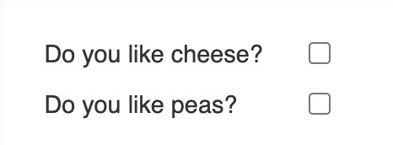
SESSION DESCRIPTION (Cont..)
Input Label
The <label> HTML element represents a caption for an item in a user interface.
Associating a <label> with an <input> element offers some
major advantages:
The label text is not only visually associated with its corresponding text input; it is programmatically associated with it too. This means that, for example, a screen reader will read out the label when the user is focused on the form input, making it easier for an assistive technology user to understand what data should be entered.
When a user clicks or touches/taps a label, the browser passes the focus to its associated input (the resulting event is also raised for the input). That increased hit area for focusing the input provides an advantage to anyone trying to activate it — including those using a touch-screen device.

Slide 31
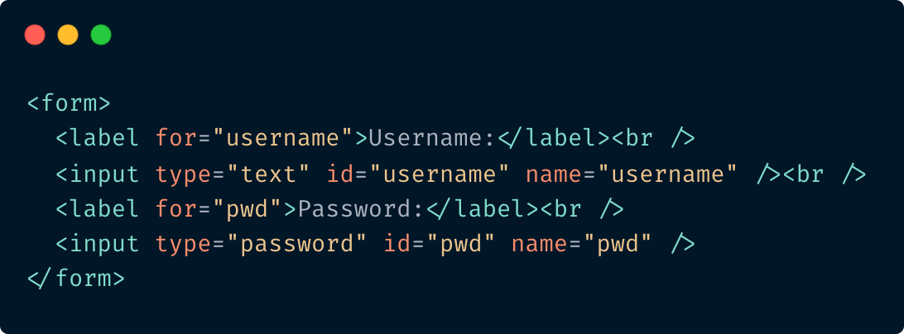
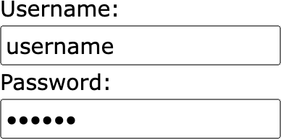
SESSION DESCRIPTION (Cont..)
Input Types
Here are the main input types:
<input type="button">
<input type="checkbox">
<input type="color">
<input type="date">
<input type="email">
<input type="file">
<input type="hidden">
<input type="password">
<input type="radio">
<input type="search">
<input
type="submit">
<input type="tel">
More about you can read here: https://www.w3schools.com/html/html_form_input_types.asp

Slide 32
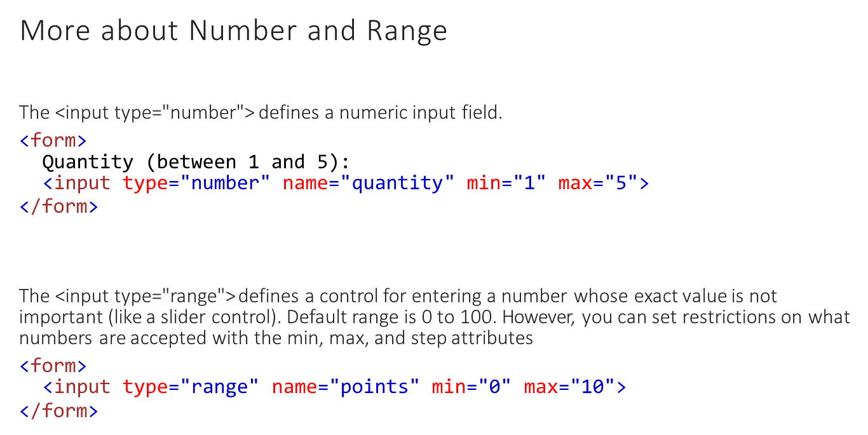
SESSION DESCRIPTION (Cont..)

Slide 33
Attributes
SESSION DESCRIPTION (Cont..)
disabled
max
maxlength
placeholder
pattern
readonly
tabindex
required
size
step
value
min
<input type="number" min="10" max="100" value="50">

Slide 34
SESSION DESCRIPTION (Cont..)
More about pattern
<input pattern="regexp">
The pattern attribute specifies a regular expression that the <input> element's value is checked against.
The pattern attribute works with the following input types: text, date, search, url, tel,email, and password.
Use the global title attribute to describe the pattern to help the user.

Slide 35
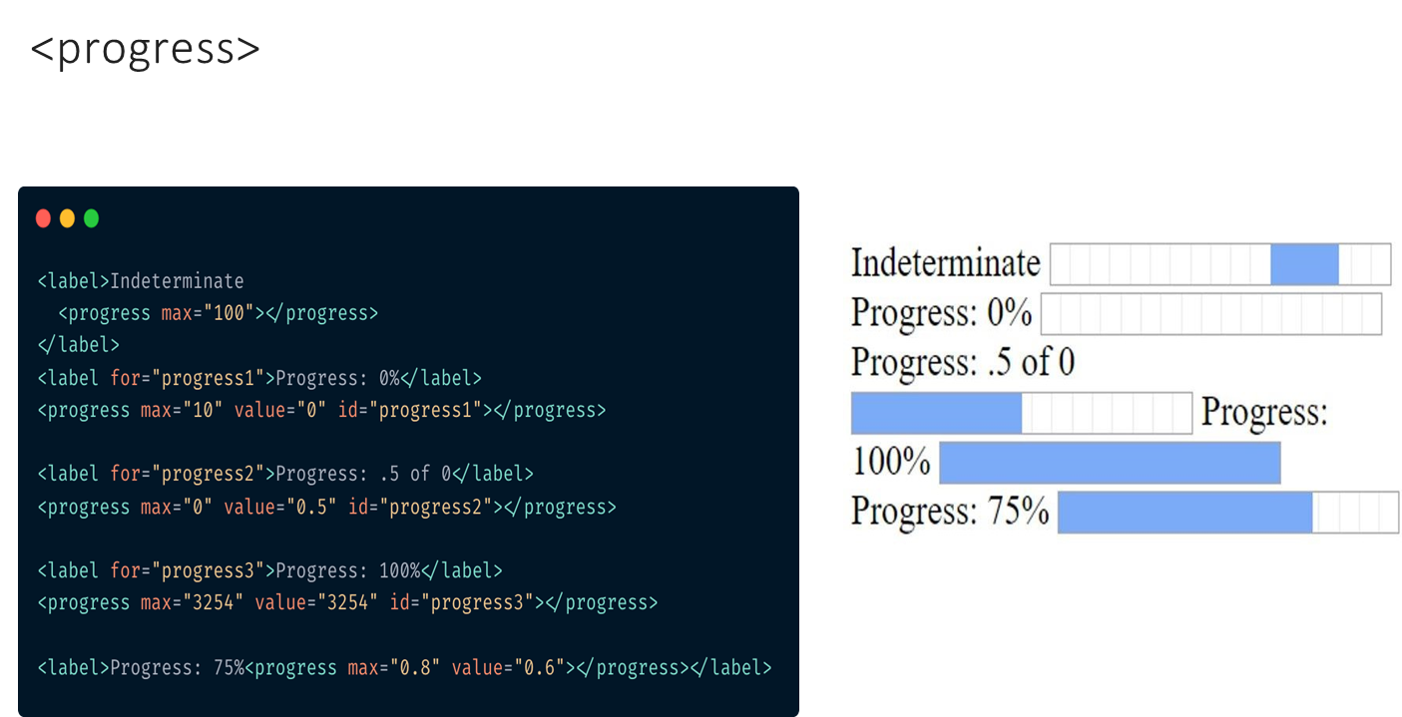
SESSION DESCRIPTION (Cont..)

Slide 36
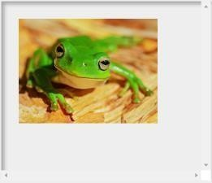
SESSION DESCRIPTION (Cont..)
Tag <picture>
serves as a container for zero or more <source> elements and one <img> element to provide versions of an image for different display device scenarios.
The browser will consider each of the child <source> elements and select one corresponding to the best match found; if no matches are found among the
<source> elements, the file specified by the <img> element’s src attribute is selected.
<picture>
<source srcset="/media/examples/picture-small.png" media="(max-width: 1000px)">
<source srcset="/media/examples/picture-wide.png" media="(min-width: 1000px)">
<img src="/media/examples/picture-narrow.png">
</picture>

Slide 37
SESSION DESCRIPTION (Cont..)
Srcset image attribute
Allows you to list multiple alternative image sources which vary in pixel density
This allows the browser to pick an image of the appropriate quality for the user’s device
<img src=“images/low-res.jpg"
srcset=“images/low-res.jpg 1x, images/high-res.jpg 2x, images/ultra- high-res.jpg 3x">

Slide 38
SESSION DESCRIPTION (Cont..)
Canvas and SVG
Provide native drawing functionality
Completely integrated into HTML5 documents (part of DOM)
Can be styled with CSS
Can be controlled with JavaScript
Use for animation, charts, images, pixel manipulation, and so on
Canvas supports 2D and 3D (WebGL)

Slide 39
SESSION DESCRIPTION (Cont..)
HTML5 Canvas
The HTML <canvas> element is used to draw graphics, on the fly, via JavaScript.
The <canvas> element is only a container for graphics.
Canvas has several methods for drawing paths, boxes, circles, text, and adding images.
<canvas id="myCanvas" width="200" height="100"></canvas>

Slide 40
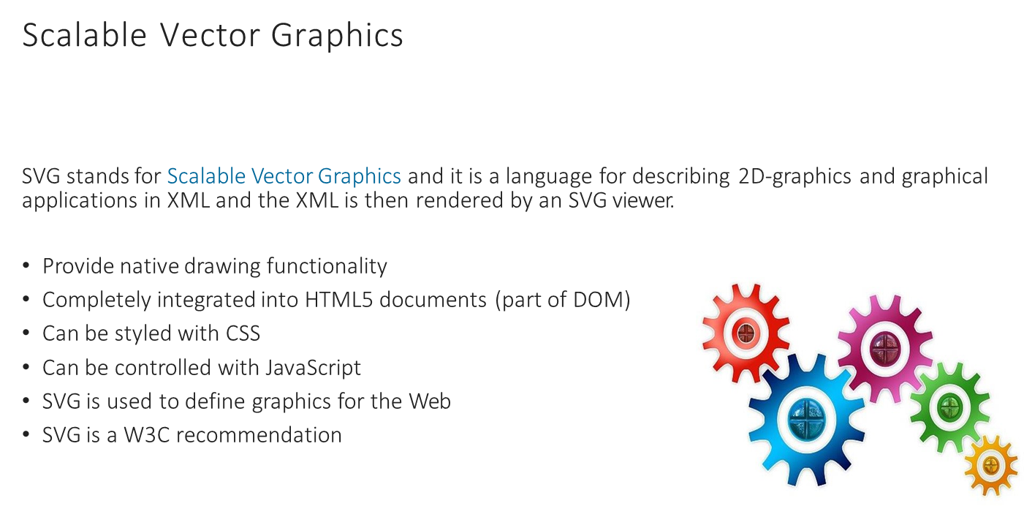
SESSION DESCRIPTION (Cont..)

Slide 41
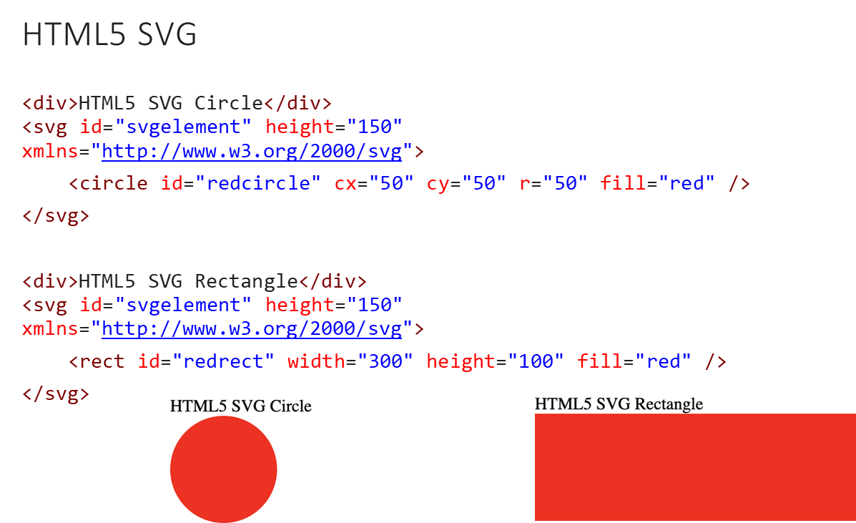
SESSION DESCRIPTION (Cont..)

Slide 42
SESSION DESCRIPTION (Cont..)
Canvas and SVG
CANVAS
Resolution dependent
No support for event handlers
Poor text rendering capabilities
You can save the resulting image as .png or .jpg
Well suited for graphic-intensive games
SVG
Resolution independent
Support for event handlers
Best suited for applications with large
rendering areas (Google Maps)
Slow rendering if complex (anything that uses the DOM a lot will be slow)
Not suited for game applications

Slide 43
Html Linter
SESSION DESCRIPTION (Cont..)
Is used to avoid potential errors.
Ready to use, you don’t need additional configurations.
You CAN’T change any rules.
You won’t be able to push your code if there any errors occurred.
You can find all rules in .htmllintrc file in the root of your project.
Detailed rules description: https://github.com/htmllint/htmllint/wiki/Options

Slide 44
REFERENCES FOR FURTHER LEARNING OF THE SESSION
Additional links
https://validator.w3.org/
https://developer.mozilla.org/
https://caniuse.com/
https://github.com/htmllint/htmllint/wiki/Options
w3schools. HTML5 Introduction
SVG Tutorial
Canvas Tutorial
Manipulating SVG Icons With Simple CSS

Slide 45
THANK YOU
Team – Course Name

